Slide 1
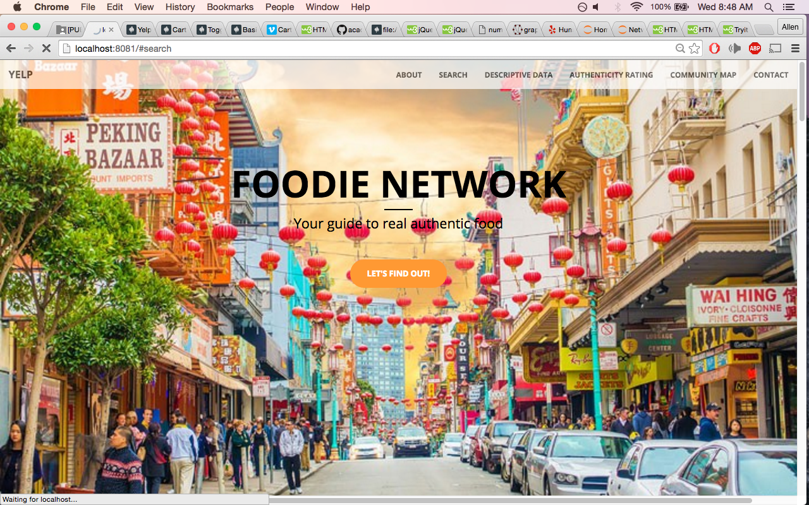
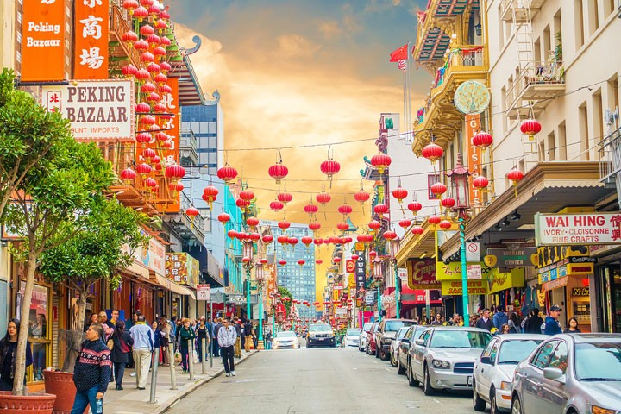
Foodie Network
Your guide to authentic Yelp reviews

Slide 2
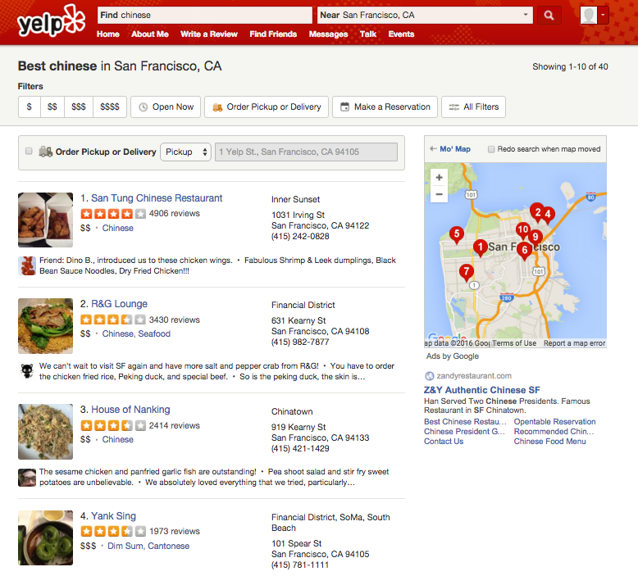
Which one is Authentic?
Notes:
Have you ever had trouble finding an authentic cuisine?
Having in Oklahoma for 2 years, I had difficulty finding genuine Chinese food that reminded me of home so I developed a network model and app to solve this problem.
First, how did I define authenticity?

Slide 3
Adjusted Yelp Rating for Authenticity
Users who have rated one cuisine with higher frequency receive higher weighting for their Yelp star rating
Users who never rated or rated one cuisine with lower frequency receive lower weighting for their Yelp star rating
Readjust Restaurant rating based on authentic users
Chinese
Chinese
U1
Chinese
U2
Asian Fusion
Notes:
To me, users who review one cuisine with higher frequency naturally provide more authentic reviews.
In this graph on the right, User 1 has higher authenticity than U2 because he/she has rated more Chinese restaurants so his rating receives higher significance
Estimate Authenticity using elite reviewers whom rate a lot of the same cuisine
Some one who rates a lot of Chinese restaurants is a foodie and they should know what is considered good quality OR bad quality
Readjust Yelp rating based on qualified users within the community
If Restaurant rating increases after weighting = means high frequency reviewers likely thought it was more authentic than originally rated
If Restaurant rating decreases after weighting = means high frequency reviewers likely thought it was less authentic than orignally rated

Slide 4



Data Pipeline
Beautiful Soup
MongoDB
Scrape Yelp
User Data (Elite)
iGraph/Graphtools
Amazon EC2
Community Detection
Numpy/ Pandas
Build Authenticity Metric
Review Data
Centrality Measure
Flask
Web App
San Francisco (>500)
Data Collection
Modeling
Evaluation
Visualization
Notes:
My data pipeline consists of scraping Yelp reviews with greater than 500 reviews and then using graphtools (network library) to conduct community detection modeling. I then migrated the data to pandas to build my authenticity metric. Finally I implemented everything in a web application.
1. Stored data into mongdb
2. Built model with graphtools,
3. I build my authenticity metric
4. Implemented everything in a webapp
(Spent too long)

Slide 5
Modeling Yelp Social Network
Restaurants (businesses) and Reviewers (users) inside community are more similar than outside community
Goal: Leverage the community in reweighting star ratings for authenticity
Notes:
To describe my modeling approach, a built a network model which consists of users and businesses.
Users and business can be clustered into communities based similarity of their connections (for example ones that have similar tastes in restaurants will be clustered in same community)
I tried many different implementations of community detection algorithms for large networks which optimize modularity with community
During the modeling phase, I constructed a social network of Yelp Reviews
I then clustered yelp reviews with each vertex representing either a business or a user where within community connectivity is higher than between community connectivity.
My goal was to use communities to compute authentic Yelps star rating
First run a community detection algorithm to find communities of reviews that are more similar within community than between community
A community does not have to describe a single cuisine (only similar tastes), it does describe a community of users with similar taste in restaurants
Every User has a different qualification to review a particular cuisine
No shortage of features but not no label to validate results
Maybe I could do a survey of the clientele?
Tend to eat only one type of cuisine
Immigrants rather cook themselves if they could do it better
Yelp is biased towards yuppies
San Francisco is harder to detect signal vs. rural areas
how many versions of menus they have (languages)
Non-authentic restaurant names – panda, golden, china, dragon, bamboo, fortune, happy, wok, express, golden, palace, take-out, fortune cookies, zodiac place mats
Menu items and names
Harder to tell when restaurants are cuisine fusion
I used big data

Slide 6
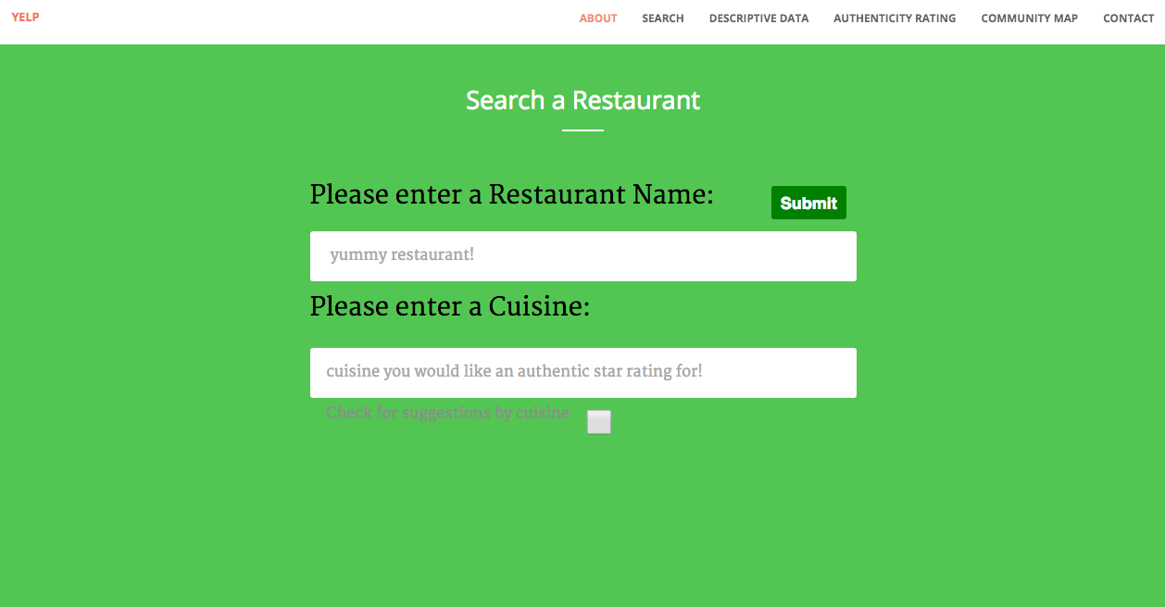
Notes:
How does my app work?
A user specifies a restaurant and a cuisine to evaluate authenticity for.

Slide 7
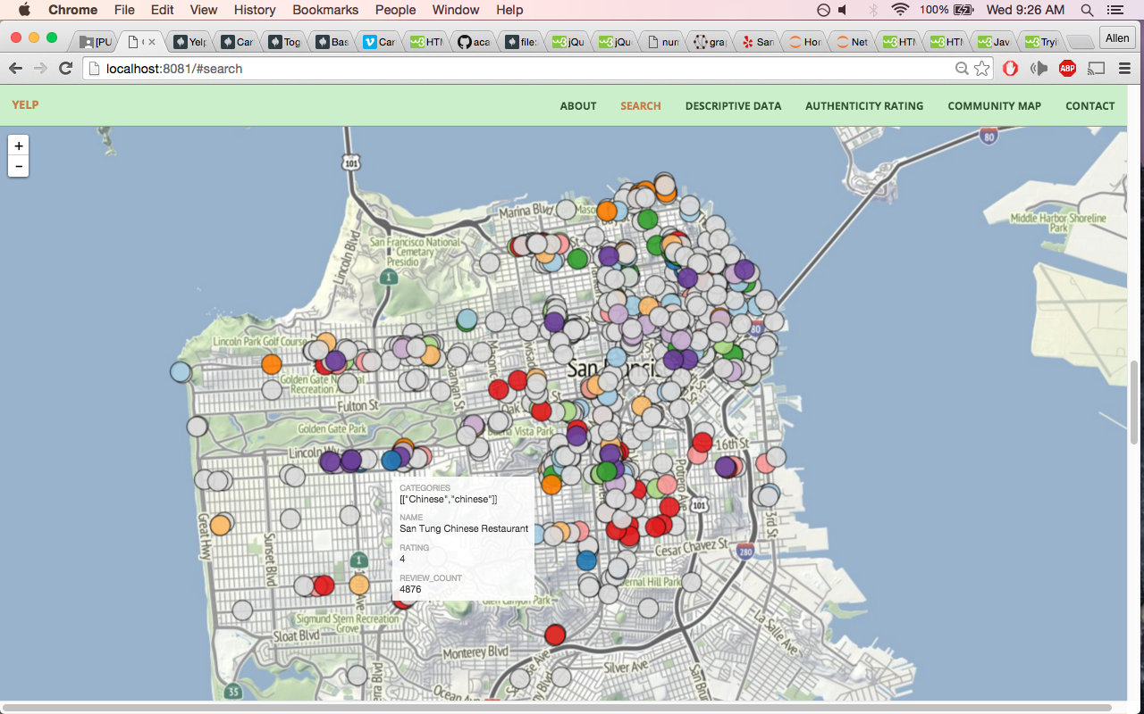
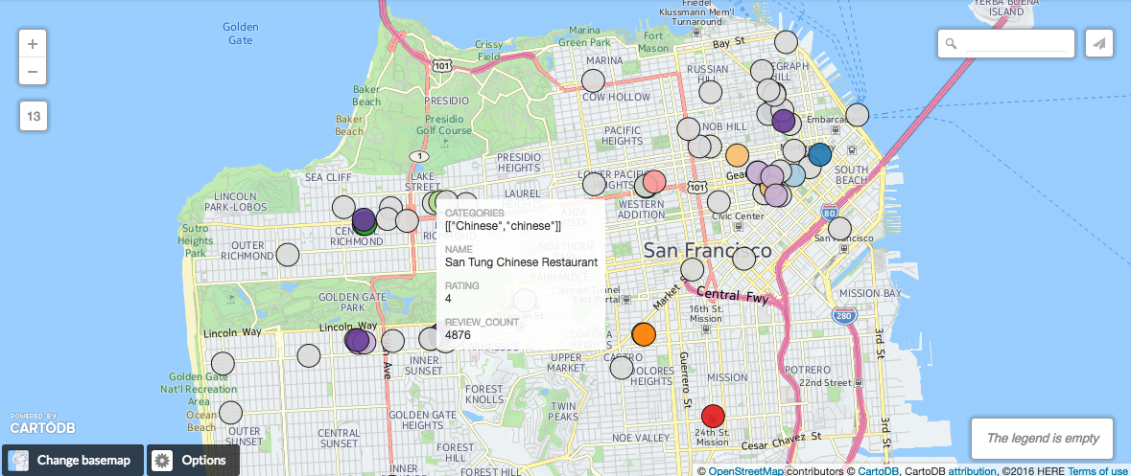
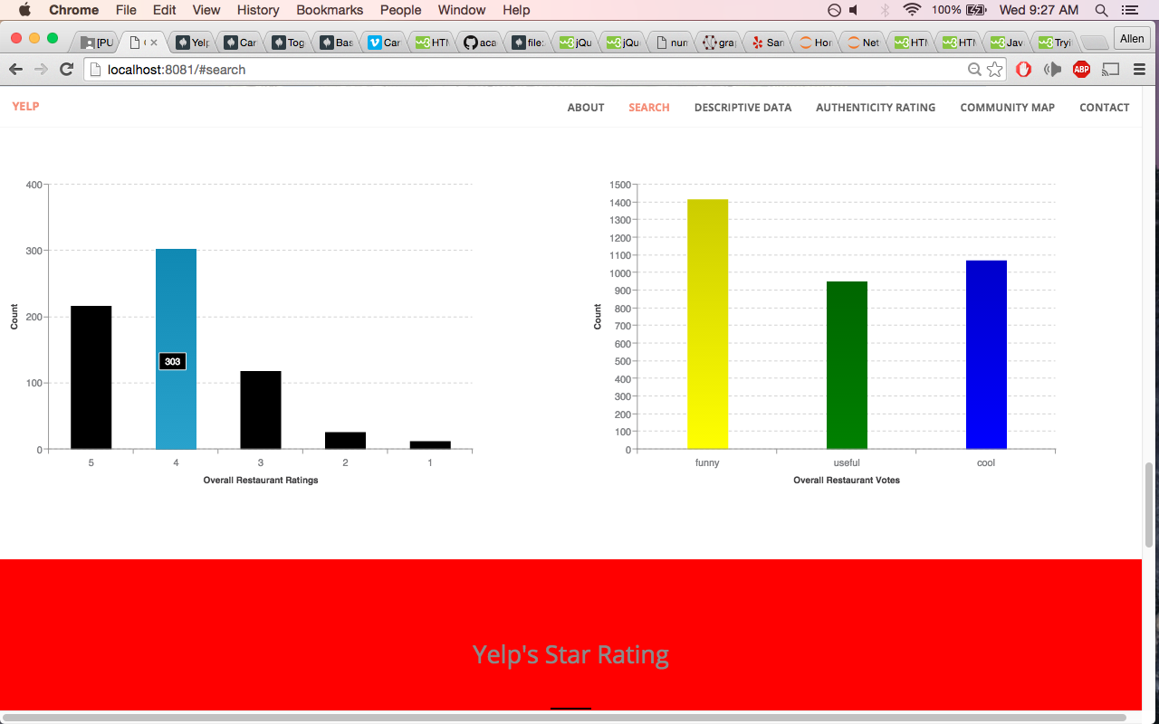
Notes:
First, you gives you a community map of similar restaurants

Slide 8
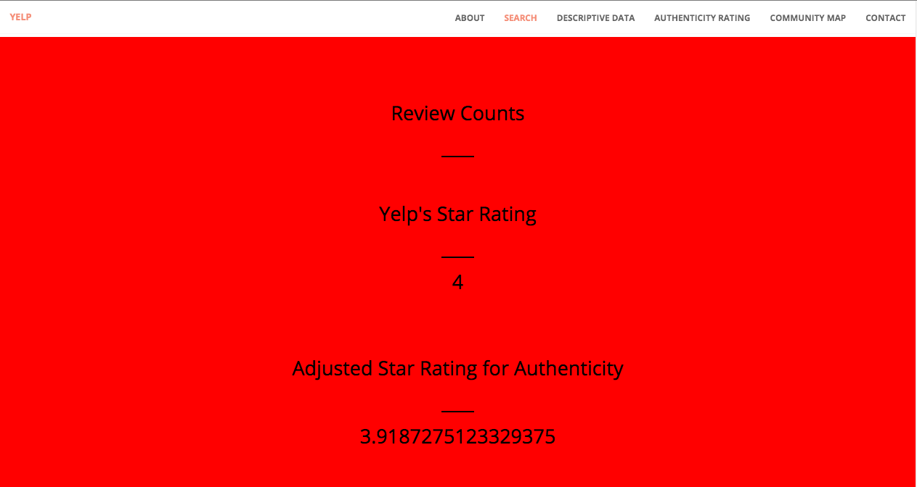
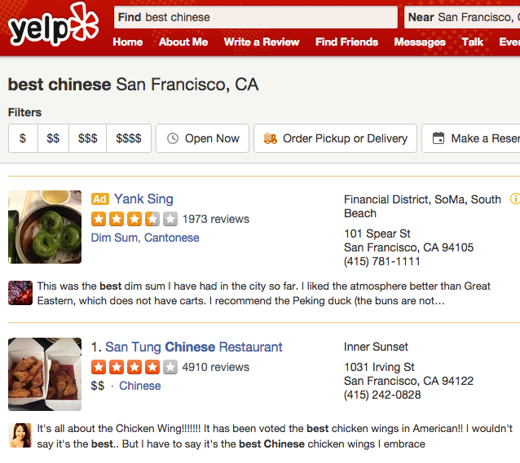
Adjusted Yelp Review for San Tung Restaurant
Review Counts: 4,910
Original Yelp Star Rating: 4
Reweighted Yelp Star Rating: 3.9
Ratio: 0.975
Less Authentic
Notes:
FINALLY…
Makes sense because high review count, more reviewers who are likely less qualified to rate chinese cuisines

Slide 9
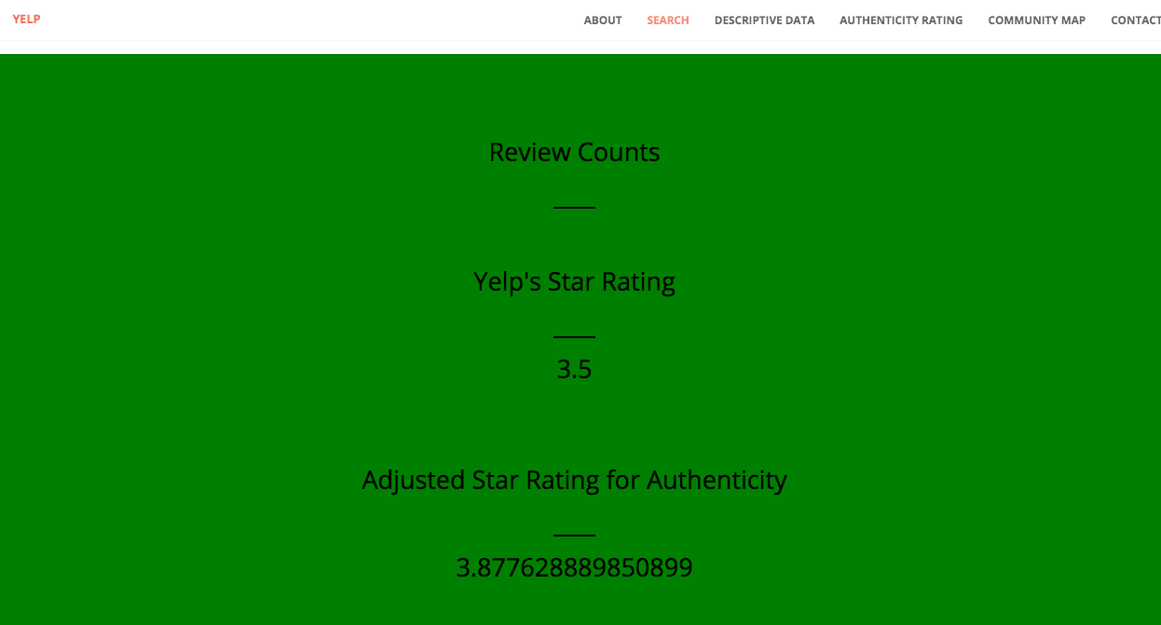
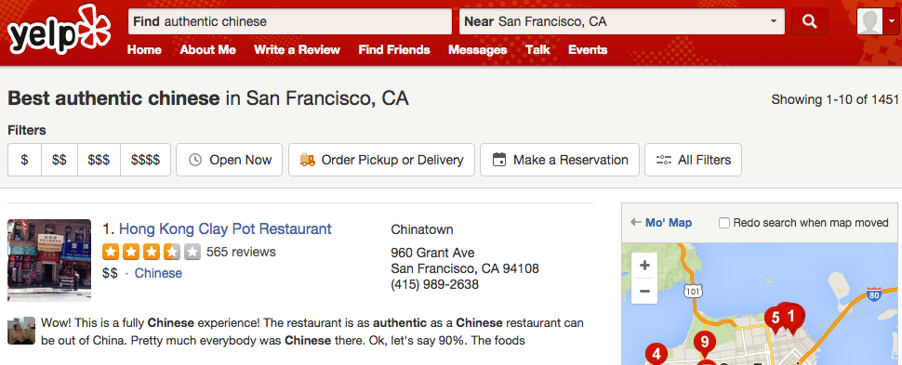
Adjusted Yelp Review for Hong Kong Clay Pot Restaurant
Review Counts: 565
Original Yelp Star Rating: 3.5
Reweighted Yelp Star Rating: 3.9
Ratio: 1.1
More Authentic
Notes:
Nice because kind of validates yelp’s “most authentic” result

Slide 10
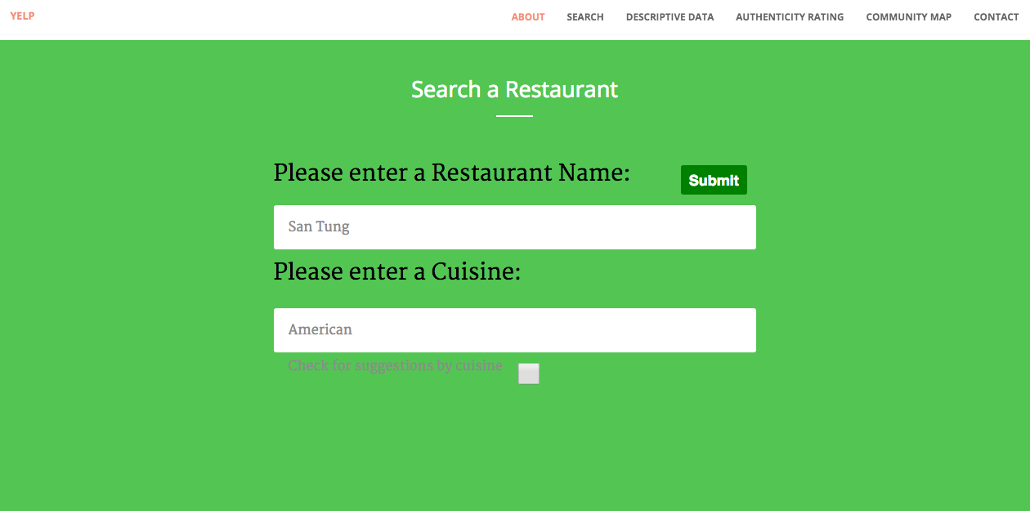
San Tung Restaurant
Ratio: 1.05
Hong Kong Clay Pot Restaurant
Ratio: 1.15
Notes:
One last example makes the most compelling use-case for this app and that is seeing how different restaurants appeal to people who are Authentic reviewers of different cuisines? Use this to market to different cuisines.

Slide 11
Conclusions and Further Work
Social Network Graphs are versatile and can provide significant insight on which restaurants are likely more authentic
Add user-user connections along with user-user weights
Create authentic recommendations based on user inputs
Notes:
In Conclusion, I built model using network graphs that produces pretty sensible results
In the future, the can be significantly improved if I add in user-user relationships and weight their connection by number of restaurants they have in common.
Since unsupervised, its hard to validate. So we need to A/B Test.

Slide 12
Foodie Network Thank you!
Email: Alee7135@gmail.com
Github: https://github.com/alee7135
LinkedIn: https://www.linkedin.com/in/allen-lee-a0900b2a
Notes:
App is kind of like WalkScore.com or Rateyourneighborhood. Gives you statistics about your interests, you decide what to do with it.

